Slide 1





Phishing URL Detection

Slide 2
Objectives
The objective of this project is to develop a robust machine learning-based system for detecting phishing URLs, leveraging a random forest model to enhance accuracy and reliability. By analyzing various features extracted from URLs, the project aims to improve the identification of malicious sites and thereby strengthen cybersecurity defenses against phishing attacks.

Slide 3
Benefits
The benefits of the phishing URL detection system include:
Enhanced Security: Provides accurate detection of malicious URLs, reducing the risk of phishing attacks and protecting sensitive information.
Real-time Analysis: Offers timely identification and blocking of phishing attempts, minimizing potential damage.
Scalability: Easily integrates into various applications and systems, making it adaptable to different security infrastructures.
Efficient Resource Use: Optimized for low memory and CPU usage, ensuring minimal impact on system performance.
Improved Accuracy: Utilizes a random forest model to capture complex patterns in URL data, leading to higher detection accuracy compared to traditional methods.

Slide 4
Data Sharing Agreement
Sample File Name: phishing_site_urls.csv
Number of Columns: 2
Columns Name: URL and Label

Slide 5
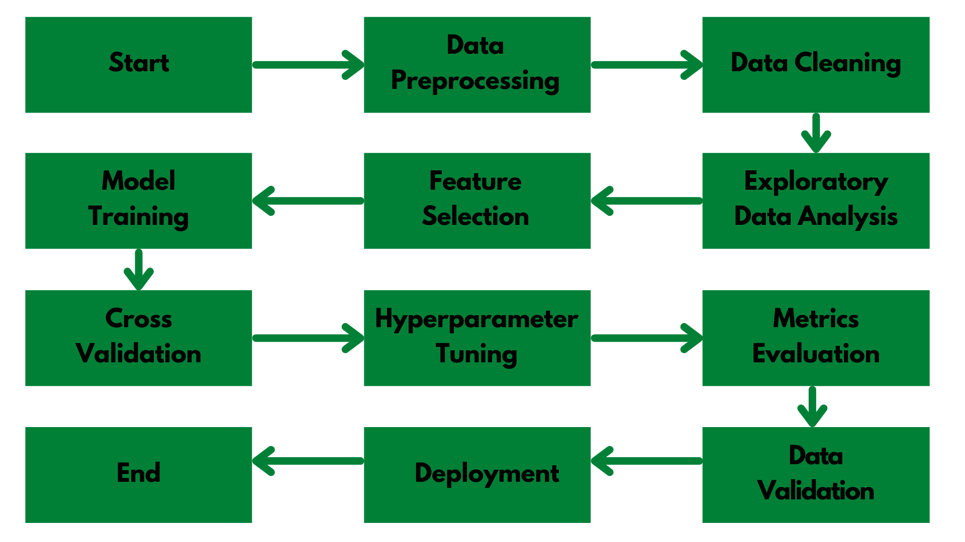
Architecture

Slide 6
Step 1: Data Preprocessing and EDA
Data Cleaning:
Remove Duplicates: Eliminate duplicate rows to avoid redundant data that could skew results.
Handle Missing Values: Address missing values by removing rows with missing data or using imputation techniques to ensure a complete dataset.
Feature Extraction:
URL Parsing: Break down URLs into components like domain and path to analyze their structure.
Feature Engineering: Create meaningful features from URL components, such as length, keyword presence, and subdomain count, which can help in distinguishing between phishing and legitimate URLs.
Text Processing:
Tokenization: Split URLs into tokens for detailed analysis.
Normalization: Convert URLs to lowercase to ensure consistency in feature extraction.
Remove Special Characters: Strip out irrelevant special characters to focus on essential URL features.
Encoding Labels:
Convert categorical labels (e.g., "phishing" and "legitimate") into numerical values so they can be used by machine learning algorithms.
Splitting Data:
Divide the dataset into training and testing sets to train the model and evaluate its performance on unseen data.

Slide 7
Step 2: Logistic Regression
Logistic regression is a straightforward and interpretable model used in phishing URL detection. It helps establish a baseline for classification performance by predicting whether a URL is phishing or legitimate based on extracted features like URL length and number of subdomains. The model provides clear insights into feature importance through its coefficients, showing which features most influence the prediction. It is efficient and suitable for initial experiments, offering a reference point for comparing more complex models. While it may not capture all patterns as well as advanced models, it serves as a useful tool for understanding and refining the classification process.

Slide 8
Step 4: XGBoost Algorithm
XGBoost (Extreme Gradient Boosting) is a highly efficient and accurate machine learning algorithm ideal for phishing URL detection. It excels in handling diverse features and automatically manages missing values. By using gradient boosting, XGBoost builds an ensemble of trees sequentially, where each tree corrects the errors of the previous ones, thus improving model accuracy. Its built-in regularization parameters prevent overfitting, ensuring the model generalizes well to new data. This makes XGBoost a powerful choice for achieving high performance in identifying phishing URLs.

Slide 9
Step 5: Random Forest Classifier
A Random Forest Classifier is a versatile and powerful machine learning algorithm used for classification tasks, including phishing URL detection. It works by creating an ensemble of decision trees during training time and outputting the mode of the classes (classification) of the individual trees. This ensemble approach enhances the model's accuracy and robustness by reducing the risk of overfitting that individual trees may face. The algorithm handles large datasets with higher dimensionality effectively and can capture complex patterns in data. Random Forests are also capable of estimating feature importance, providing insights into which features are most influential in the classification process.

Slide 10
Frequent Q&A
Q) What is the source of the data?
Data was collected from Kaggle.
Q) What is the complete flow of your project?
Refer to slide no 5 for better understanding.
Q) What techniques were you using for data pre-processing?
In data pre processing, we analyzed the data, found the important features, and based on the domain knowledge, we eliminated the unnecessary columns. We also tried to fill Missing Values with mean, median and mode but still the data have the same correlations. Thus removing the columns with high NaN values was the better option for us.

Slide 11
Frequent Q&A
Q) How did you choose the model?
After implementing hyper parameter tuning, we were able to do model selection based on the metrics and how it was performing on unseen data. The final model we chose was Random Forest Classifier.
Q) How did you verify urls?
To determine if a URL is suspicious, extract key features such as URL length, number of subdomains, special characters, and presence of suspicious keywords. Combine these with host-based features like domain age and IP address information, and content-based features such as forms asking for sensitive information. Use heuristic analysis to check for signs like the use of HTTP instead of HTTPS and similar-looking domain names. Train a machine learning model, such as a Random Forest Classifier, on a labeled dataset of URLs to classify them as phishing or legitimate based on these features. This approach enables accurate and efficient identification of suspicious URLs in real-time applications.

